Slide 1

CSE1107
Discrete Mathematics
M.M.A. Hashem, PhD
Presented by
Md. Badiuzzaman Shuvo
Lecturer
Dept. of CSE,KUET

Slide 2
Propositional Logic - 2 more defn…
A tautology is a proposition that’s always TRUE.
A contradiction is a proposition that’s always FALSE.
p | ¬p | p ∨ ¬p | p ∧ ¬p
T | F
F | T
T
T
F
F
11/08/24

Slide 3
Propositional Logic - an unfamous ≡
if NOT (blue AND NOT red) OR red then…
¬(p ∧ ¬q) ∨ q ≡ ¬p ∨ q
¬(p ∧ ¬q) ∨ q | ≡
 | ≡
 | ≡
 | ≡
(¬p ∨ ¬¬q) ∨ q
DeMorgan’s
(¬p ∨ q) ∨ q
Double negation
¬p ∨ (q ∨ q)
Associativity
¬p ∨ q
Idempotent
11/08/24

Slide 4
Propositional Logic - one last proof
Show that [p ∧ (p → q)] → q is a tautology.
We use ≡ to show that [p ∧ (p → q)] → q ≡ T.
[p ∧ (p → q)] → q
≡ [p ∧ (¬p ∨ q)] → q
substitution for →
≡ [(p ∧ ¬p) ∨ (p ∧ q)] → q
distributive
≡ [ F ∨ (p ∧ q)] → q
uniqueness
≡ (p ∧ q) → q
identity
≡ ¬(p ∧ q) ∨ q
substitution for →
≡ (¬p ∨ ¬q) ∨ q
DeMorgan’s
≡ ¬p ∨ (¬q ∨ q )
associative
≡ ¬p ∨ T
excluded middle
≡ T
domination
11/08/24

Slide 5
Predicate Logic - everybody loves somebody
Proposition, YES or NO?
3 + 2 = 5
X + 2 = 5
X + 2 = 5 for any choice of X in {1, 2, 3}
X + 2 = 5 for some X in {1, 2, 3}
YES
NO
YES
YES
11/08/24

Slide 6
Predicate Logic - everybody loves somebody
Alicia eats pizza at least once a week.
Garrett eats pizza at least once a week.
Allison eats pizza at least once a week.
Gregg eats pizza at least once a week.
Ryan eats pizza at least once a week.
Meera eats pizza at least once a week.
Ariel eats pizza at least once a week.
…
11/08/24

Slide 7
Predicates
Alicia eats pizza at least once a week.
Define:
EP(x) = “x eats pizza at least once a week.”
Universe of Discourse - x is a student in cse1207
A predicate, or propositional function, is a function that takes some variable(s) as arguments and returns True or False.
Note that EP(x) is not a proposition, EP(Ariel) is.
…
11/08/24

Slide 8
Predicates
Suppose Q(x,y) = “x > y”
Proposition, YES or NO?
Q(x,y)
Q(3,4)
Q(x,9)
NO
Predicate, YES or NO?
Q(x,y)
Q(3,4)
Q(x,9)
YES
YES
NO
NO
YES
11/08/24

Slide 9
Predicates - the universal quantifier
Another way of changing a predicate into a proposition.
Suppose P(x) is a predicate on some universe of discourse.
  Ex. B(x) = “x is carrying a backpack,” x is set of cse1207 students.
The universal quantifier of P(x) is the proposition:
“P(x) is true for all x in the universe of discourse.”
We write it ∀x P(x), and say “for all x, P(x)”
∀x P(x) is TRUE if P(x) is true for every single x.
∀x P(x) is FALSE if there is an x for which P(x) is false.
∀x B(x)?
11/08/24

Slide 10
Predicates - the universal quantifier
Universe of discourse is people in this room.
B(x) = “x is wearing sneakers.”
L(x) = “x is at least 21 years old.”
Y(x)= “x is less than 24 years old.”
Are either of these propositions true?
∀x (Y(x) → B(x))
∀x (Y(x) ∨ L(x))
A: only a is true
B: only b is true
C: both are true
D: neither is true
11/08/24

Slide 11
Predicates - the existential quantifier
Another way of changing a predicate into a proposition.
Suppose P(x) is a predicate on some universe of discourse.
  Ex. C(x) = “x has a candy bar,” x is set of cs173 students.
The existential quantifier of P(x) is the proposition:
“P(x) is true for some x in the universe of discourse.”
We write it ∃x P(x), and say “for some x, P(x)”
∃x P(x) is TRUE if there is an x for which P(x) is true.
∃x P(x) is FALSE if P(x) is false for every single x.
∃x C(x)?
11/08/24

Slide 12
Predicates - the existential quantifier
Universe of discourse is people in this room.
B(x) = “x is wearing sneakers.”
L(x) = “x is at least 21 years old.”
Y(x)= “x is less than 24 years old.”
Are either of these propositions true?
∃x B(x)
∃x (Y(x) ∧ L(x))
A: only a is true
B: only b is true
C: both are true
D: neither is true
11/08/24

Slide 13
Predicates - more examples
L(x) = “x is a lion.”
F(x) = “x is fierce.”
C(x) = “x drinks coffee.”
All lions are fierce.
Some lions don’t drink coffee.
Some fierce creatures don’t drink coffee.
Universe of discourse is all creatures.
∀x (L(x) → F(x))
∃x (L(x) ∧ ¬C(x))
∃x (F(x) ∧ ¬C(x))
11/08/24

Slide 14
Predicates - more examples
B(x) = “x is a hummingbird.”
L(x) = “x is a large bird.”
H(x) = “x lives on honey.”
R(x) = “x is richly colored.”
All hummingbirds are richly colored.
No large birds live on honey.
Birds that do not live on honey are dully colored.
Universe of discourse is all creatures.
∀x (B(x) → R(x))
¬∃x (L(x) ∧ H(x))
∀x (¬H(x) → ¬R(x))
11/08/24

Slide 15
Predicates - quantifier negation
Not all large birds live on honey.
∀x P(x) means “P(x) is true for every x.”
What about ¬∀x P(x) ?
  Not [“P(x) is true for every x.”]
  “There is an x for which P(x) is not true.”
∃x ¬P(x)
So, ¬∀x P(x) is the same as ∃x ¬P(x).
¬∀x (L(x) → H(x))
∃x ¬(L(x) → H(x))
11/08/24

Slide 16

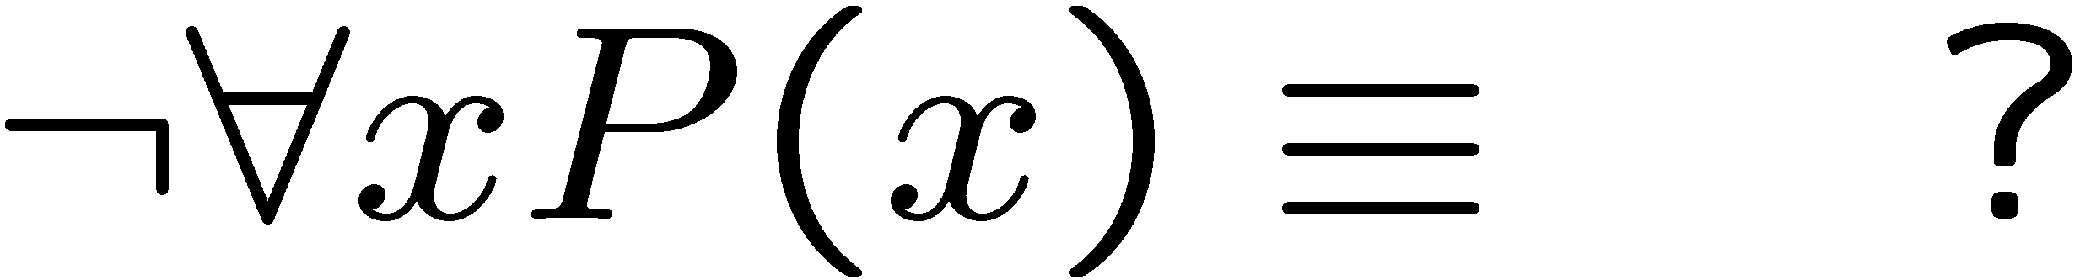
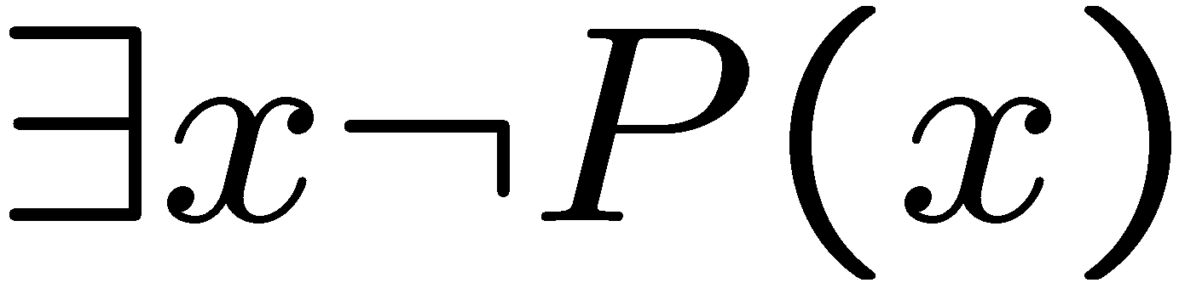
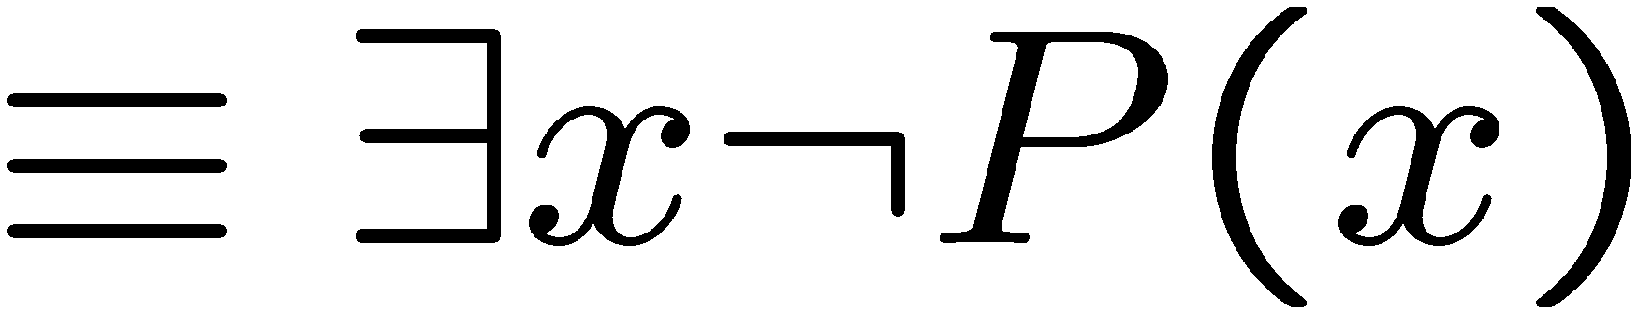
Negations of Quantified Statements
Everyone likes football.
What is the negation of this statement?
Not everyone likes football = There exists someone who doesn’t like football.
(generalized) DeMorgan’s Law
Say the domain has only three values.
11/08/24
The same idea can be used to prove it for any number of variables.

Slide 17
Predicates - quantifier negation
No large birds live on honey.
∃x P(x) means “P(x) is true for some x.”
What about ¬∃x P(x) ?
  Not [“P(x) is true for some x.”]
  “P(x) is not true for all x.”
∀x ¬P(x)
So, ¬∃x P(x) is the same as ∀x ¬P(x).
¬∃x (L(x) ∧ H(x))
∀x ¬(L(x) ∧ H(x))
11/08/24

Slide 18

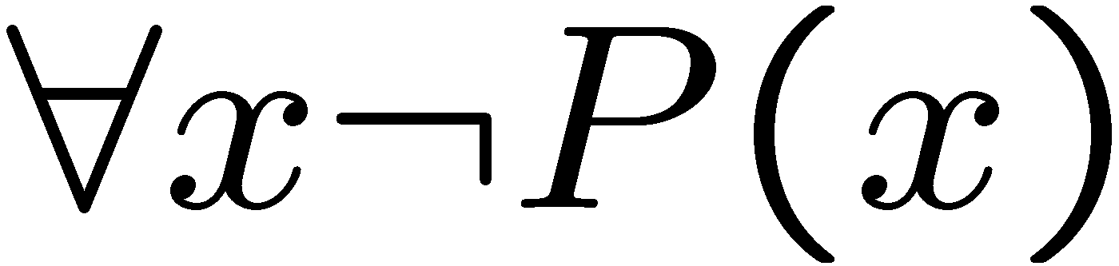
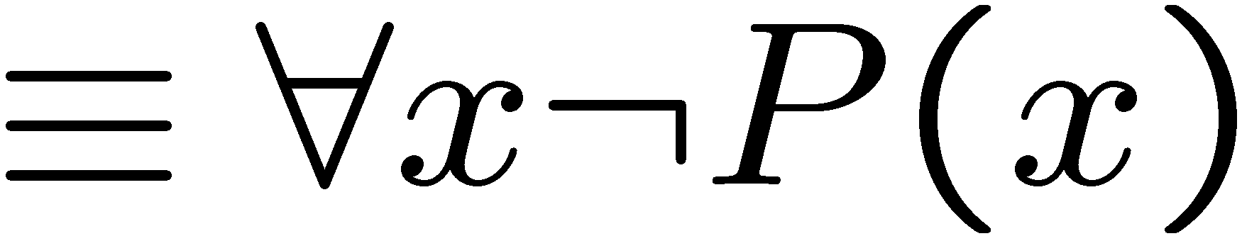
Negations of Quantified Statements
There is a plant that can fly.
What is the negation of this statement?
Not exists a plant that can fly = every plant cannot fly.
(generalized) DeMorgan’s Law
Say the domain has only three values.
11/08/24
The same idea can be used to prove it for any number of variables.

Slide 19
Predicates - quantifier negation
So, ¬∀x P(x) is the same as ∃x ¬P(x).
So, ¬∃x P(x) is the same as ∀x ¬P(x).
General rule: to negate a quantifier, move negation to the right, changing quantifiers as you go.
11/08/24

Slide 20
Predicates - quantifier negation
No large birds live on honey.
¬∃x (L(x) ∧ H(x)) | ≡ ∀x ¬(L(x) ∧ H(x)) | Negation rule
 | ≡ ∀x (¬L(x) ∨ ¬H(x)) | DeMorgan’s
 | ≡ ∀x (L(x) → ¬H(x)) | Subst for →
What’s wrong with this proof?
11/08/24

